Slide 1
Information Technology for Disaster Management
- From National R & D Policy to Field Practice -
Kenzo Hiroki
Principal, International Centre for Water Hazard and Risk Management (UNESCO – ICHARM)
(Former Director for Infrastructure, Space and Ocean, Science and Technology Bureau, Cabinet Office)

Slide 2
Introduction Science and Technology Policy in Japan - How it works -

Slide 3
Position of Science & Technology in Japan
Little Natural Resources (little oil, minerals…)
Small land, large population, recurrent disasters…
Human resources and Science & Technology as the sole dynamo for sustainable national growth
Strong emphasis on Science and Technology (& Education)
4 % of GDP/ 5 years dedicated for R & D (1 % by government; 3 % by private sectors)
Governmental R & D coordinated under National Science and Technology Basic Plan

Slide 4
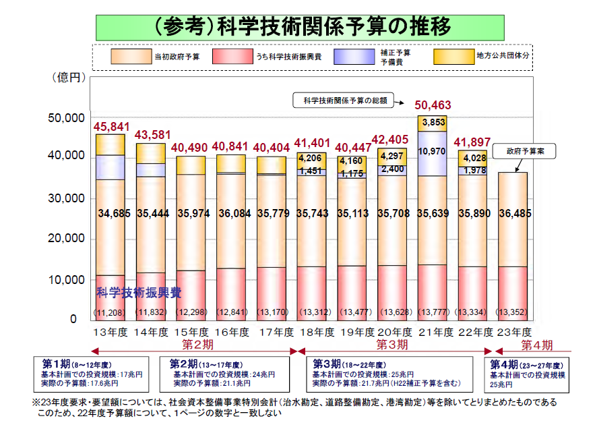
Science and Technology Budget of Japan
100 Million JPY
2001 2002 2003 2004 2005 2006 2007 2008 2009 2010 2011
2nd STBP Period 3Rd STBP Period 4th STBP Period

Slide 5
Structure of Science and Technology Policy Formulation and Implementation in Japan
Council for Science & Technology Policy (CSTP)
Chair: Prime Minsters
Members: 6 Ministers+6 Intellectual Members
Ministry of Education, Science and Technology (MEXT)
Ministry of Economy, Trade and Industry (METI),
Ministry of Land, Infrastructure, and Transport (MLIT)
Ministry of Environment ,
Ministry of Agriculture, Forest and Fishery
……
Budget, advice, coordination…
Research Institutes, Universities and Private Laboratories

Slide 6
Tools of CSTP to guide and coordinate S & T activities in Japan
Council for Science & Technology Policy (CSTP)
Secretariat : 120+ staff members (from governments, private sectors, and academia)
Policy Tools
Drafting Science & Technology Basic Plan
Reviewing progress of Basic Plan
Reviewing National R & D Projects
Budgetary Tools
Evaluation system of S & T budget proposals (SABC System)
“Action Plan” Budgeting Scheme
Special Funding Programs (FIRST)
Special Coordination Funds for Promoting S & T
CSTP to guide, advise & coordinate R & D activities of ministries, national universities and research institutes

Slide 7
The 4th Master Plan for Science Technology (2011-2015)
(1) Master plan to determine main course of actions of governmental investment in R & D in 2011-2015
(2) Investment level: 4 % of GDP/ 5 years
(3) Governmental investment: 1 % of GDP (around 25 trillion JPY (330 billion USD))
(4) Three Priority Areas
Disaster Management and Recovery
Green Innovation
Life Innovation

Slide 8
Evaluation System of R & D Budget Proposals (SABC System)
CSTP Budget Evaluation Cycle (April – March)
April : CSTP to announce R & D Resources Allocation Policy
(Priority areas, coordination policy, etc.)
May -: Ministries to start drafting budget proposals
taking RAP into account
June : CSTP to ask for public comments
Sept. : CSTP to evaluate budget proposals of Ministries
Dec. : Finance Ministry to reflect evaluation of CSTP in
assessing and deciding the draft budget
Mar. : Budget approved by Diet

Slide 9
Evaluation result for FY 2011 Budget Proposal
Reduce: 11 billion JPY (2%)
C: 3 billion JPY (3%)
B: 11 billion JPY (12%)
Accelerate: 196 billion JPY (34%)
S: 46 billion JPY (53%)
A: 27 billion JPY (31%)
Continue: 370 billion JPY(64%)
Total of new projects: 87 billion JPY
Total of ongoing projects: 580 billion JPY

Slide 10
CSTP Action Plan for Priority Policy Areas (2010- )
CSTP proactively help Ministries to formulate effective, cohesive budget proposals under new Action Plan initiative
The budgetary process led by CSTP under the Action Plan
CSTP to engage Ministries in discussion on priority areas
CSTP to help creating budget package proposals by Ministries
CSTP to call for public comments
Finance Ministry to reflect the package in the draft budget
Budget Package in 2011
Super solar power (low cost, high efficiency); Wood-based Biomass Utilization; Revolutionizing battery/fuel batteries; Low-carbon energy system by IT, Greening social infrastructure by earth observation system

Slide 11
A catastrophic disaster halts national and global growth
-

Slide 13
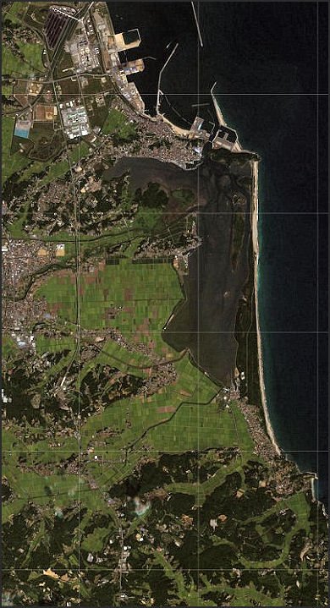
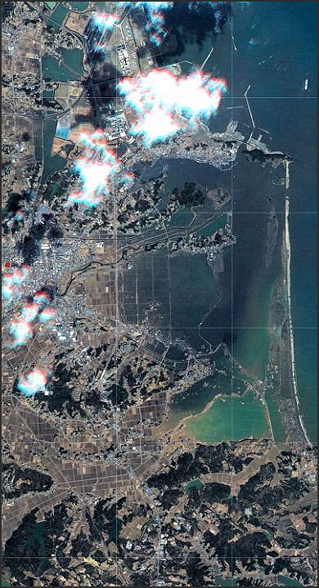
Source: Factsandddetails

Slide 14
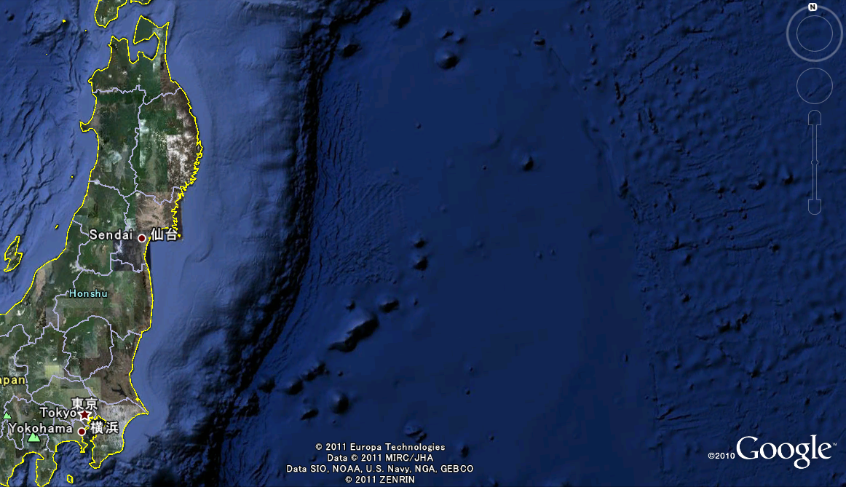

Damage of Great earthquake and Tsunami in East Japan
Pref./ region | Affected irrigation area(ha) | Affected houses | Water supply down | Power supply down
 | (ha) | houses | houses | houses
Aomori | 79 | 272 | 3,900 | 916,960
Iwate | 1,838 | 17,729 | 180,000 | 816,499
Miyagi | 15,002 | 46,240 | 620,000 | 1,545,494
Fukushima | 5,923 | 1,961 | 400,000 | 381,788
Ibaraki | 531 | 929 | 430,000 | 869,402
Chiba | 227 | 671 | 370,000 | 353,043
Total* | 23,600 | 67,802 | 2,003,900 | 4,883,186
Affected fishing port
Height of Tsunami
(m)
Tsunami arrival time
Oohunato port 22min (maximum height).
Miyako 40min (maximum height)
8.4
9.6
Aomori
19.0
1
1
12.17
Ichikawa,
Hachinohe-shi
2
Akita
3
9.0
2
15.0
Kuji-port,
Kuji-shi
Iwate
4
3
5
Tarou,
Miyako-shi
Yamagata
17.6
4
6
Kanahama
Miyako-shi
Miyagi
10.35
5
7
8
7.71
6
9
14.0
Kamaishi port
7
Rikuzentakata
-shi
9
5.9
8
*only listed area
Fukushima
10
Onagawacyo
9
Hokkaido
3,000
Akita
669,414
Yamagata
529,774
11
Higashimatusima-shi
4.8
10
12
Arahama ,
Watari-cyo
Tochigi
4.8
Gunma
11
13
Fukushima daiichi
Nucleus power station
Gunma
211,838
Saitama
368,834
Tokyo
120,013
Ibaraki
6.02
12
13
Shikura port, Iwaki-shi
14
Ootsu
Tochigi
553,999
Kanagawa
1,304,646
14
Ooaraimachi
Asahi-shi
Reported by newspaper Asahi on April 10th

Slide 15
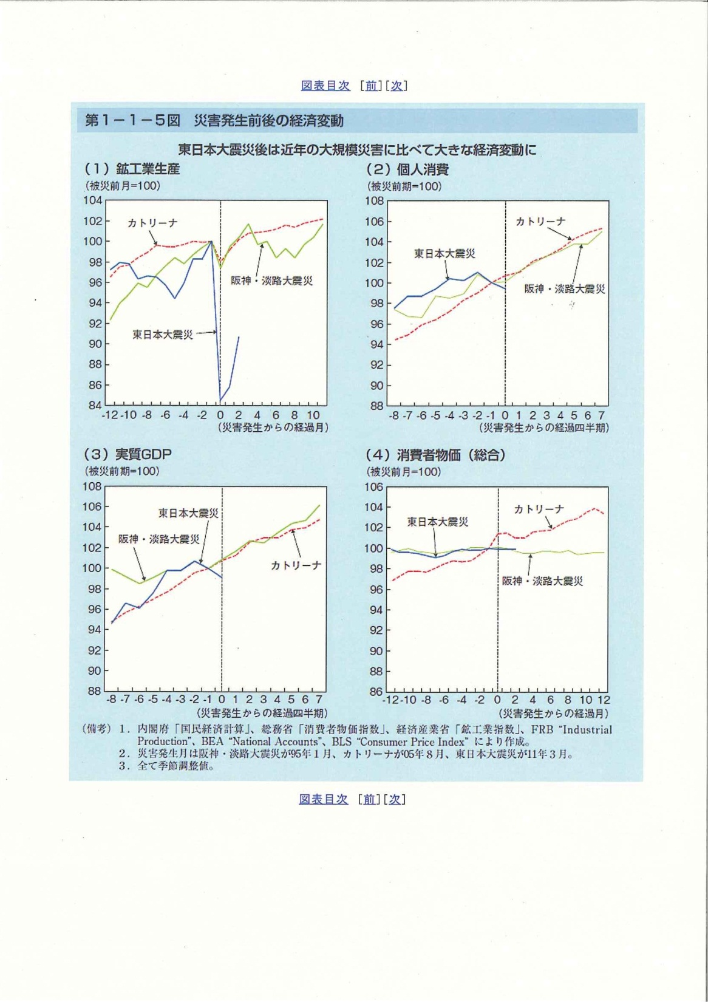
Effect of Mega-disasters to National Industrial Production
Before disaster: 100
Hurricane Katrina
Hyogo Earthquake
East Japan Great Earthquake & Tsunami
Months before & after the disaster

Slide 16
Disaster Management is our national priority, but… What happens in fields at Disaster Emergency?

Slide 17
Disaster management at fields is a battle (struggle) on information
Time for information collection/analysis/ dissemination are getting shorter
Information at emergency is confused, per se
There is trade-off relation between accuracy and collection time for information

Slide 18
Action by Disaster Manager at emergency
A case after downpour in 2000, Fukushima
○ ８：３０ → A first report from a patroller that a levee erosion
has been found. Breakage of the levee is possible.
○ ８：４０ → Disaster Manager decided that the levee will be
breached soon. Advice is given to Mayor to issue
evacuation order to citizens→ Communication
hot-line was established with Mayor
○ ９：００ → Evacuation order has been spread among citizens
○ ９：０２ → The levee was breached but no casualties
○１１：２０ → Request to Defense Force for support
○１３：００ → Rehabilitation works were commenced
○ ２：００ → Rehabilitation works completed

Slide 19
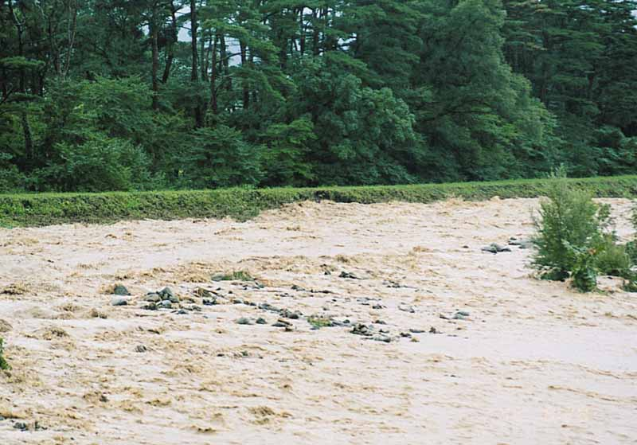
８:２９ a.m.

Slide 20
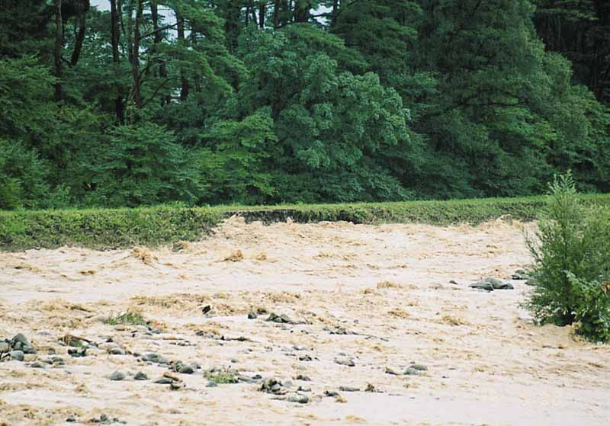
８:３０am

Slide 21
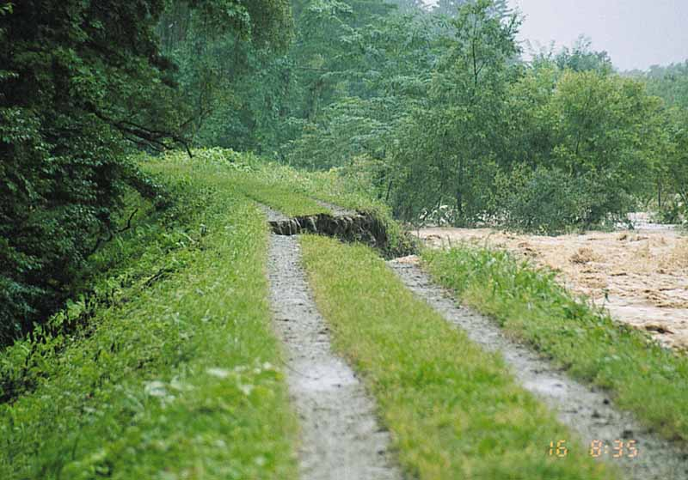
８:３５a.m.

Slide 22
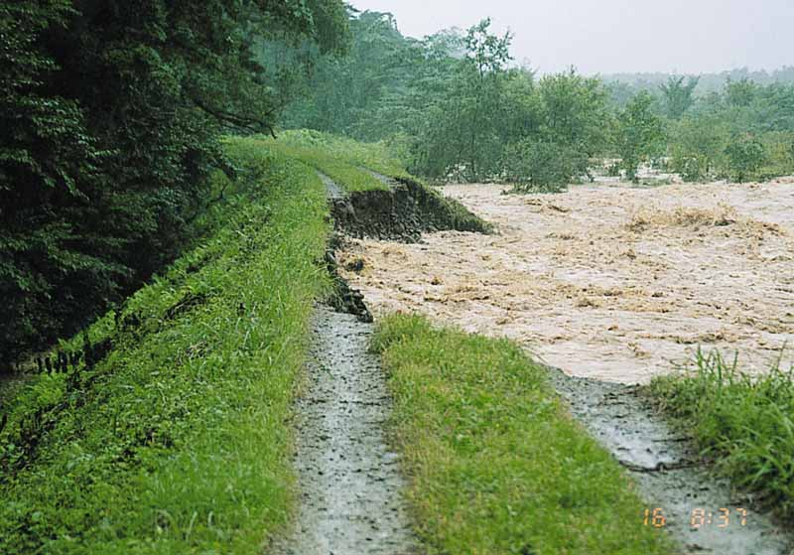
８:３７a.m.

Slide 23
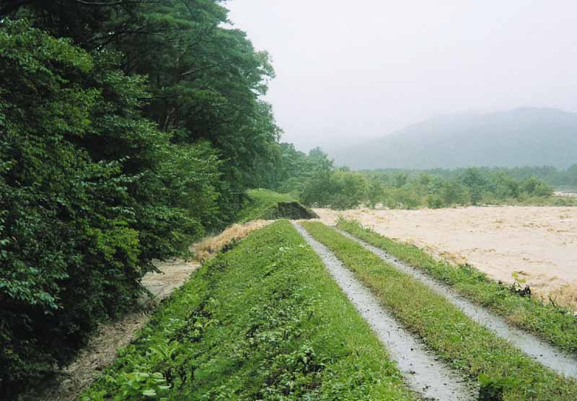
Levee was breached at 9:02 a.m.

Slide 24
What actions are required for Field Disaster Managers at emergency?
Directives to save critical infrastructure
Communication with Mayors/Authorities to ensure evacuation and safety of the public
Sharing critical information with Central Government/Local authorities
Provision of accurate but comprehensive information to Media
→ Multiple, timely decisions have to be made under quickly changing situation/priorities

Slide 25
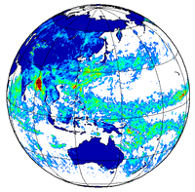
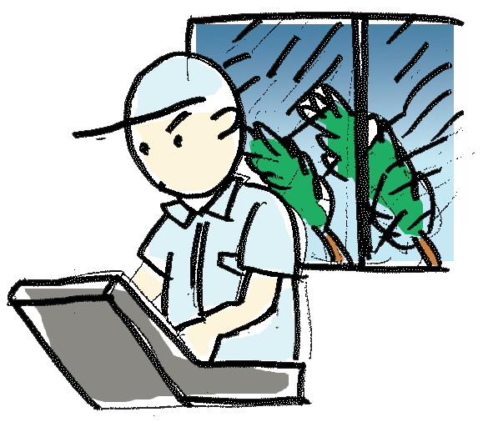
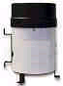


What happens to flood managers in emergency
Hydro/Meteoro-/Geological Data
Analysis System
Local situation
Expectation
Pressure
Accurate forecast;
Timely warning;
Advice to citizens
Handling media
Time Shortage;
Changing situation;
Multiple tasks;
Many inquiries…
Information Technology is critical for disaster management

Slide 26
How can Information Technology help to meet key challenges in disaster management?
Four Key Challenges
Shortening time for collection and analysis of critical disaster information (i.e. for forecast & warnings)
Vertically Integrating disaster information systems to serve diverse user needs
Horizontally bridging information gap to coordinate activities at fields
Building a useful system responding to new technology

Slide 27
Challenge 1
Shortening time for information collection and analysis

Slide 28
Integrated Flood Analysis System (IFAS)
IFAS is a flood run-off analysis/forecast system for developing countries
IFAS uses rainfall/geographical data by satellite
Flood discharge is calculated without (costly) observation station on ground.
IFAS system software is freely retrievable from website.
Rainfall and other data are taken from free source of space agencies.
Developing countries can start flood forecast at no-cost.

Slide 29
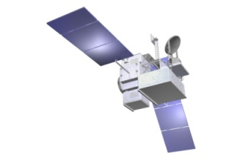
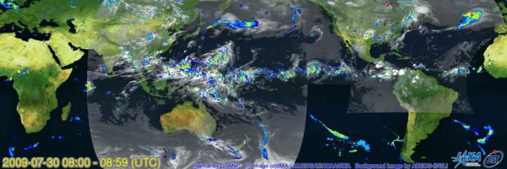
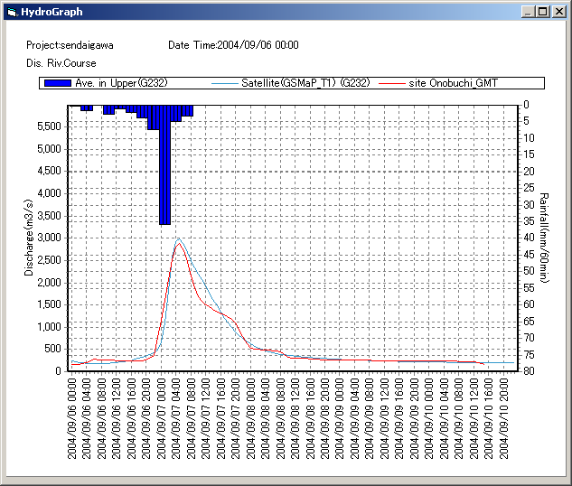
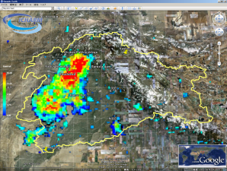


IFAS: Flood Analysis/Forecast/Warning System at No-cost
Rainfall/Watershed data by Satellite
People’s Action
Receiving alert
Courtesy of JAXA
Forecast and Warning
SMS message
via Cellular-phone provider
Run-off analysis by IFAS

Slide 30
Challenge for IFAS: Critical 4 hours
It takes 4 hours for IFAS from rainfall observation to delivery of forecast because:
It takes 3 hours from collection of observation data signal (NOAA, ESA, JAXA and JMA) to delivery of data set
It takes 1 hour to run data analysis to produce rainfall map

Slide 31
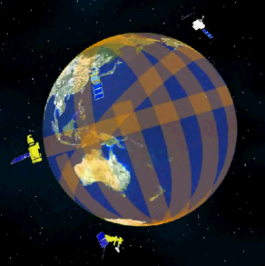

Why Time Lag?
Data collection and delivery: 3 hours
Look up table (LUT) for MWR retrievals
(once a day)
Atmospheric and surface variables
JMA GANAL, JMA MGDSST
Micro Wave Radiometer data
sensor : TMI, AMSR-E, SSM/I
Organization : NOAA, ESA
GEO IR Data
MTSAT, METEOSAT, GOES via JWA
Objective Analysis/
SST
RTM calculation
LUT for MWR
Courtesy of JAXA
JAXA
GEO IR
MWR
Rainfall Retrieval
each MWR
Global rainfall map
MWRs and GEO IRs
Gridded/
Merged MWR retrieval
Blended MWR-IR algorithm
Decoding
ftp
Data Processing & Mapping:
1 hour
Kalman Filter noise table
(once a week)
Past 30 days IR data
Production of noise table
ftp
Total Time Lag: 4 hours
IT can shorten it to: 2 hours
Public server

Slide 32
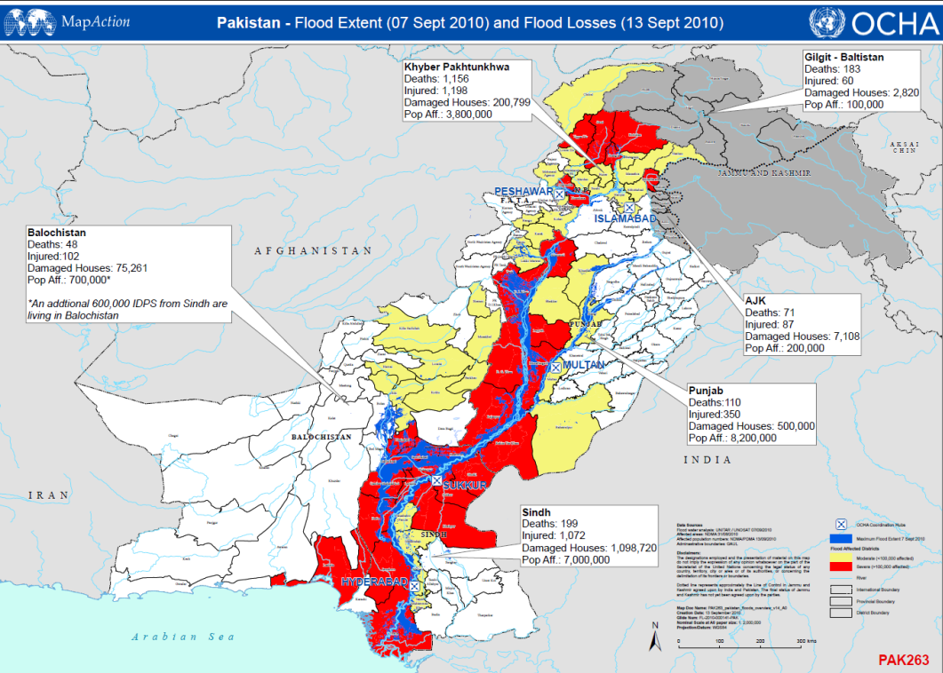

Indus River Flood in 2010, Pakistan
1,000 lives lost
Flood reaches in 2-4 hours
700 lives lost
Flood reaches in 1-3 days
We need 2 hour time-lag-reduction to save thousands of lives; IT can help them!

Slide 33
Challenge 2
Vertically Integrating disaster information systems

Slide 34
Administrative Hierarchy is vertically divided, so is Disaster Information Systems
Disaster management System Hierarchy in Japan
Administrative System
Information system
1
Central Government
Disaster Information System (DIS),
Ministerial Info. System, etc.
47
Prefectures
Prefectural Disaster Information
Systems
Help
Information
1700
Municipalities
Municipal Disaster Information
Systems (if any)
120 million
people
TV, Radio, Mobile phones
Smart phones, …

Slide 35
Players ask for different info. to work in unison
Required information to help rescuing missing people
Players | Mandate | Required information | Information source
Central Government | Decide to announce national emergency Dispatch Defense Force | Total number of missing people | National Disaster Information System (NDIS)
Prefectural government | Decide allocation of support workers to municipalities | Distribution of missing people by municipalities | Prefectural Disaster Information System (PDIS)
Municipality (Cities and towns) | Rescuing Mr. A from a collapsed house | Individual names and address of missing people | Manual records of 911, Oral report from patrollers Town DIS (if any)
System integration needed to satisfy different information needs of players

Slide 36
Challenge 3
Horizontally bridging information gap - to coordinate field activities -

Slide 37
Bridging information gap horizontally
We have to connect:
Decision makers with critical information;
Helpers with where about & profile of those who need help;
Different department officials with information on “who does what”;
Everybody taking action with anything needed for the action…
as if all of them are working on a map of the same table

Slide 38
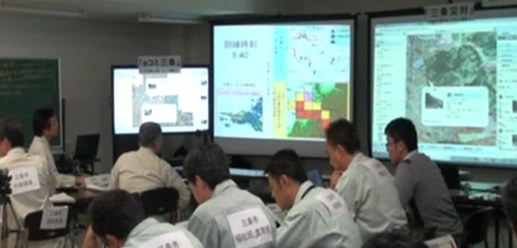
Disaster Management Drill with Integrated Disaster Information System
December, 2010
Mayor
Disaster Scenario-based Drill
Decision maker makes decision based on DIS
Critical information are identified by monitoring Decision Makers

Slide 39
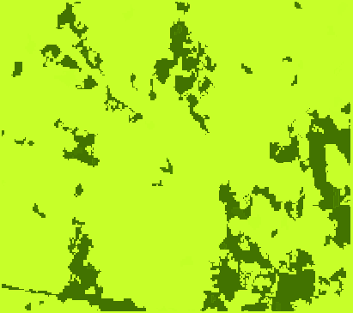
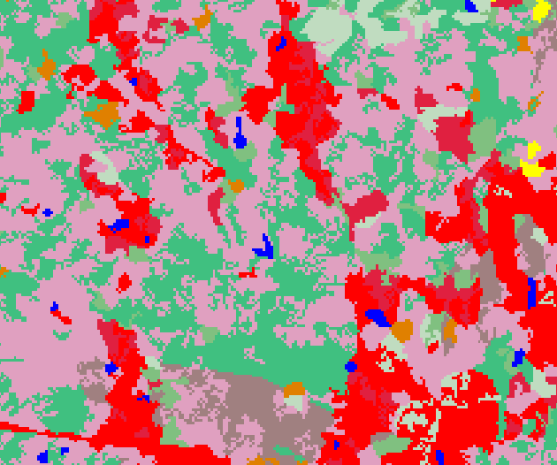
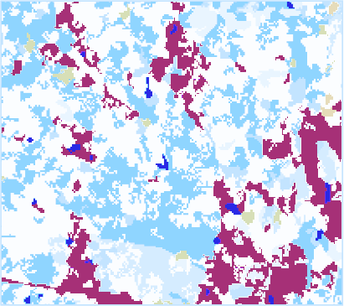
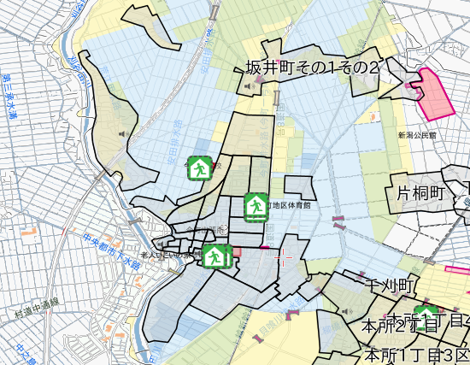
Linking three GIS systems to enable cooperation
on shared information platform
国土交通省
詳細地形データ
気象庁
気象情報
新潟県
浸水想定区域
土砂災害危険区域
気象庁
気象情報
Sanjo City Disaster
Management System
Fire Department
Response System
新潟県
総合防災
情報システム
水防・消防団からの
投稿情報（水防活動、
救出等）
Commnity-based Citizen’s Self Help System
水防・消防団からの
投稿情報（水防活動、
救出等）
市民からの
投稿情報
（浸水発生等）
支部等からの
投稿情報
（被害状況等）
避難情報
（避難準備情報
・避難勧告
・避難指示
・避難所開設情報）
避難情報
（避難準備情報
・避難勧告
・避難指示
・避難所開設情報）
市民からの
投稿情報
（浸水発生等）
避難情報
（避難準備情報
・避難勧告
・避難指示
・避難所開設情報）
首長
Rescue operation by Fire Department
水防・
消防団
災害対策本部
＜市民＞
地域住民
地域コミュニティ
事業体など
Citizen’s self help/ evacuation
Mayor’s Decision Making
市職員
39
災害リスク情報プラットフォーム（防災科学技術研究所）
防災科研が提供する「eコミウェア」
…「相互運用gサーバー」
…「eコミマップ」
Notes:
39

Slide 40

Shared Operation of Disaster Information
From:
Isolated operation of
disaster information
To:
Shared operation of
disaster information
Internet
Internet
Image
(jpg, png, gif, etc)
PDF
Stand-Alone
WebGIS
Shared information operation system
Isolated information operation system
Globally standardized interface of GIS
No integration, no synergy…
Image data
(jpg, png, gif)
…WMS: Web Mapping Service
(ISO-19128)
…WFS: Web Feature Service
(ISO-19142)
…WCS: Web Coverage Service
(ISO-191xx)
else: WPS, SOS, OLS, etc.
Vector data
(point, line, poly)
Mesh data

Slide 41
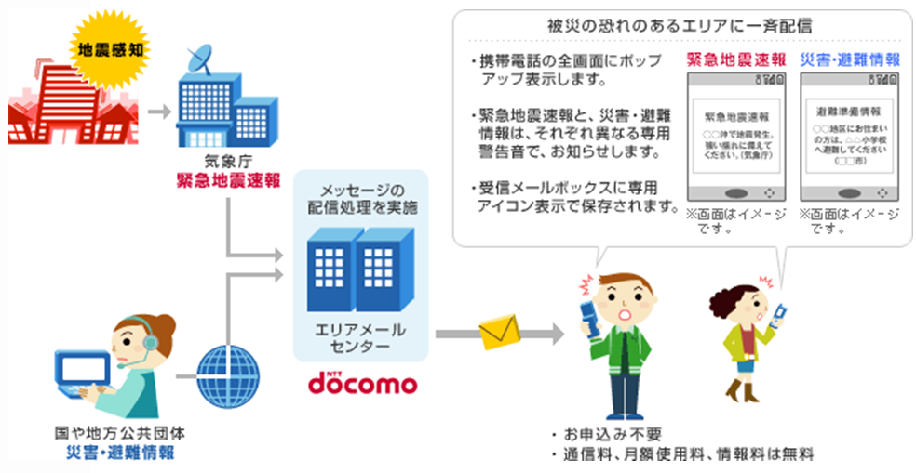
Measures in consideration of 2004 torrential rain
Provision of Evacuation Information using Mobile Phone
“Area Mail”
Area Mail
Provides disaster information such as Earthquake Early Warnings issued by the Japan Meteorological Agency and disaster and evacuation information issued by national and regional public institutions to subscribers in afflicted areas.
Each base station simultaneously transmit mail to all users in the coverage area.
Information can be received without the impact of line congestion as it uses cell broadcast service (CBS).
Simultaneously sent to areas with potential risk of disasters
A pop-up window appear on the screen.
Earthquake Early Warnings and Disaster/Evacuation Information are informed by different ringing tone.
Saved in the receive mail box with a special icon.
Japan Meteorological Agency
Earthquake Early Warnings
Area Mail Center
National and regional public institutions
Disaster and evacuation information
41
NTTdocomo HP

Slide 42
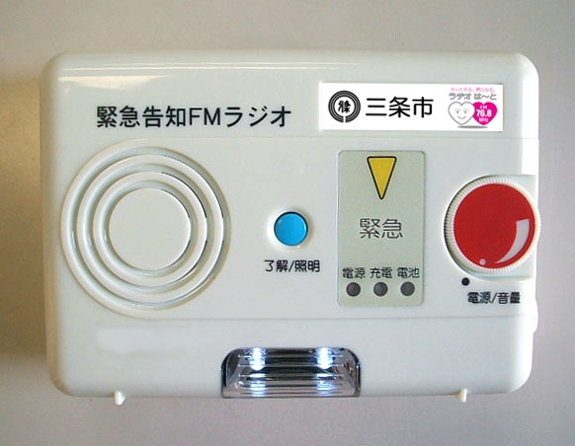
Measures in consideration of 2004 torrential rain
Distribution of Warning by FM Radio
Emergency Announcement FM Radio
It can be automatically switched on/off by central control (community broadcast or public administration) and can make announcements with high volume.
It is equipped with rechargeable batteries, and receive broadcasts even during power-outage.
42

Slide 43
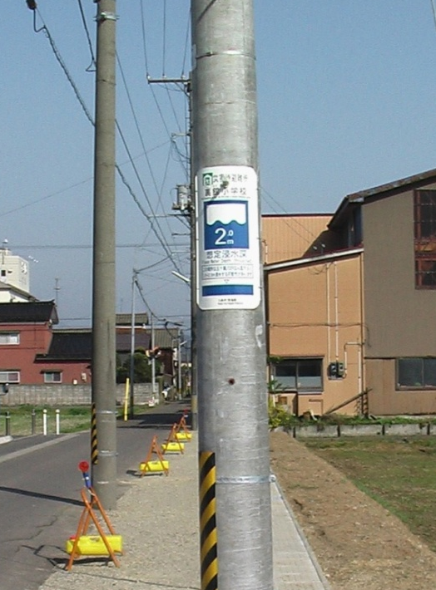
Measures in consideration of 2004 torrential rain
Street Display of Past Inundation Levels
Closest evacuation shelter
Maximum inundation depth expected at the location
43

Slide 44
Preparedness works
Comparison of damage by floods in 2004 and 2011
Total Rainfall ¹⁾
Building Damages ²⁾
Number of fatalities or missing ³⁾
1.6 times
Total
rainfall
1,006mm
9,778
buildings
90% reduction
90% reduction
12
persons
Total
rainfall
647mm
421 buildings
1 person
2004.7
2011.7
2004.7
2011.7
2004.7
2011.7
1）Kasabori rain gauge station
2）2004.7: 「7.13新潟豪雨 水害記録誌（March 2006 Niigata Prefecture)
2011.7: Produced by Niigata Prefecture based on 「第1回平成23年7月新潟・福島豪雨対策検討委員会」
3）Shinano River Downstream, Igarashi River, Kariyata River Disaster Rehabilitation Emergency Project Pamphlet (Shinano Karyu River Office, Niigata Prefecture)
44

Slide 45
Challenge 4
Building a useful system responding to a new technology

Slide 46
EEWS: A system to give emergency warning a few – ten seconds before Major Earthquake
Emergency Earthquake Warning System (EEWS)
■ Primary Wave (P-Wave)：Minor, longitudinal
seismic wave that moves faster (6 km/sec.)
Direction of seismic wave
■Secondary Wave (S-Wave)：Major, transverse
seismic wave that moves slower (3.5 km/sec.)
Speed difference between P- and S-Waves enables emergency earthquake warning a few- 10 seconds prior to arrival of major tremor
Primary waves can be detected near epicenter through seismic gaging station network (inland and sea) in Japan
JMA started full-scale EEW over Japan in 2007
Warning is given through TV, Radio, mobile phones, household interphones and internet

Slide 47

Making use of EEW
Japan Meteorological Agency
EEW Response System
Damage forecast System
EEW
Server
Analysis data
Machine Control System
Control signal
Meteorological Information Centre
Emergency Warning System
UPS
Seismic data
System Chart By Shimizu Construction Co.
Responding to EEW, the System will:
１ Forecast damage to individual buildings
２ Control production lines, equipment and machines
３ Disseminate Warning

Slide 48
The EEW, with help of IT, can be used in:
Controlling Urban Infrastructure (Power/gas supply, Signal System, communication services…)
Warning individuals through ITS, mobiles, smart phones, etc.
Activating the other warnings (tsunami, land slide…)
Safeguarding complicated Industrial System
Combination of IT and New Technology can bring higher security to industry and society

Slide 49
IT to facilitate regional and global solidarity for disaster management

Slide 50
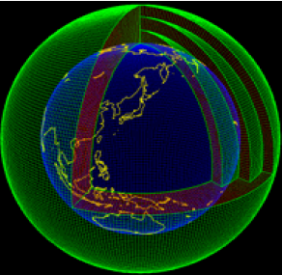
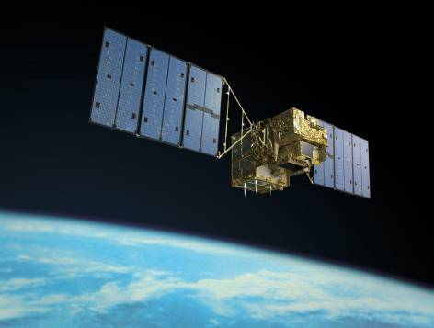
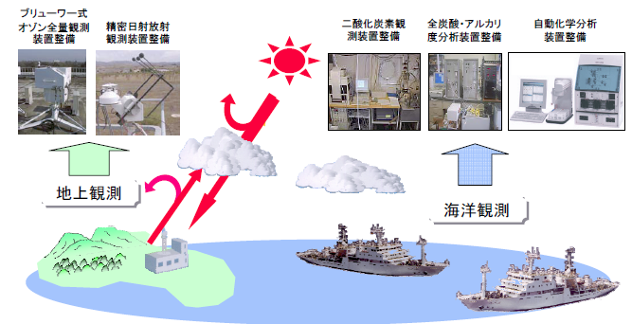
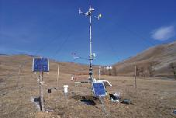
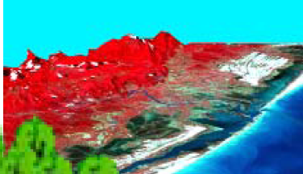
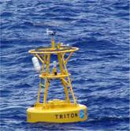
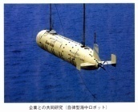
Global Water Data Integration by GEOSS
linking air, ground and sea on earth
気象予報データ
Observation Satellites
出典：気象庁提供資料
Link to simulation &
forecast system
地理情報データ
Ground & surface
sensors
Ocean and seabed
observation
Integration of database on
water, air and land
土地利用・氾濫情報
河川流量・ダム管理情報

Slide 51
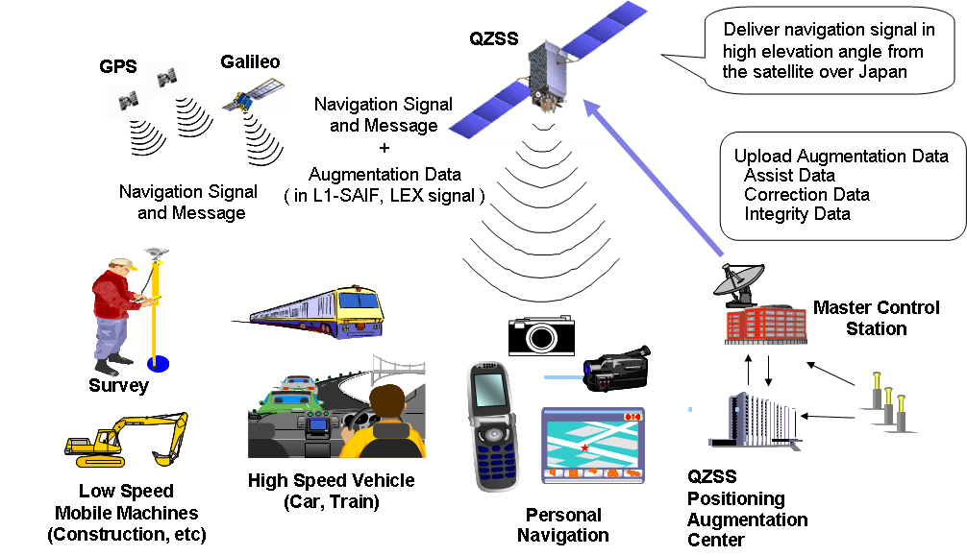

Quasi-Zenith Satellite System (QZSS) creates
New horizon of GIS application
Glonass
Monitor Station
(Electronic Reference
Point)
- 51 -
Notes:
GNSS補強サービスの構想です。
モニタステーションからの信号をセンターにおくり、補強信号を作ります。
ＱＺＳは、他の衛星と同じ信号を送出、加え補強信号を送出します。
地上では、この補強信号により、センチメートルからｍ級の精度が実現され、
色々な分野が利用することになります。
It is a design of the GNSS Augmentation service.
To send the signal from a monitor station to a center fielder
and make a Augmentation signal.
QZS sends out a signal same as other satellites and add it and send out
a augmentation signal.
On the ground, precision is from centimeter grade to m grade by this
Augmentation signal.
Various fields will use the result.
51

Slide 52
QZSS covers Asia
10 deg
20 deg
Ground track of a QZS
Minimum Elevation Contour for 3 QZS over 24 hours
* for maximum elevation of visible satellites
52
Notes:
52

Slide 53
What are needed to strengthen regional solidarity?
Proactively shared information among countries and institutions
Regional Framework for key players to act “for the benefit of the Region”
More Joint R & D project dedicated to the Region
Global and Regional open societies of scientists and practitioners (Yes, PRAGMA!) to engage in multi-disciplinary collaboration with each other

Slide 54
What benefit will the regional solidarity bring?
Fast, effective response at emergency
Joint cohesive action to mitigate the impact
Preventing future shocks from spreading in the region
Making undoable doable to save lives and properties
New investment opportunity in the Region
IT Community and Disaster community can work together for the people of the region and the world

Slide 55
Can you help?

Slide 56
Yes, you can!
Thank you

